Slide 1
EC544 Team 1 – Challenge 7
Abdulaziz Alhassan
Konstantino Sparakis
Wenyng Zhang

Slide 2
Design Strategy
Maintain Distance from wall until there is a detected gap
Turn function takes over on gap Detection
Predetermined states, allow car to determine where it is and which direction to turn and which wall to follow after turn.
External Sunspot used as Kill switch
Click and hold for car to move forward
Click left button to reset cars state to 0

Slide 3
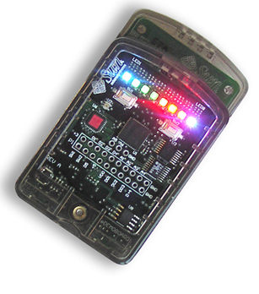
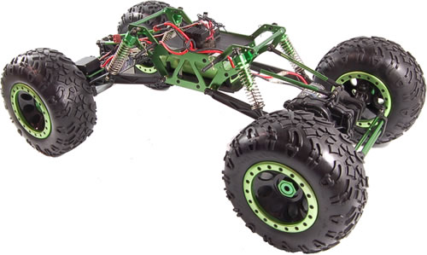
Data Flow
-Left Button Reset to State 0
-Right Button allow movement of wheels

Slide 4
Challenges
Range of IR sensor is short which lead to false gap detection
Thus beacon is sometime not triggered
Calibrating of the turning function is very dependent on vehicle battery. So depending on battery state collision with wall is very likely.
We had many technical difficulties getting the car to run. i.e. wheels falling off , 2/3 sunspots GPIO pins not working , and Improper charging

